Slide 1
How Do I Become Part
of S-STEM?
S-STEM:
Bridging Our Students to Their Future
Interested FRESHMAN students should indicate their interest in ACCEND through the CEAS Pre-Admissions Office.
For more information about joining S-STEM, please visit our website:
http://www.eng.uc.edu/sstem-bcee/
or contact
Dr. Anant R. Kukreti
Department of Biomedical, Chemical and Environmental Engineering
College of Engineering and Applied Science
University of Cincinnati
Cincinnati, OH 45221-0012
Phone: 513-556-4105
Fax: 513-556-6754 / 513-556-4162
E-Mail: anant.kukreti@uc.edu
Funded by National Science Foundation Grant #1356656
A National Science Foundation Program for
“Scholarships in Science, Technology, Engineering, and Mathematics (S-STEM)” for
Biomedical Engineering,
Chemical Engineering, and
Environmental Engineering Undergraduate Students
A Scholarship Program Providing:
Academic Support
Stipend Support
Tuition Support
Research Experience
Business Experience
Department of Biomedical, Chemical and Environmental Engineering
College of Engineering and Applied Science
University of Cincinnati
Cincinnati, Ohio 45221-0012
College of Engineering and Applied Science

Slide 2
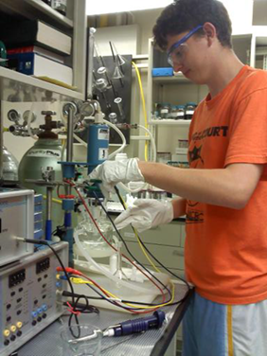
What is
S-STEM?
What can S-STEM
Do For You?
Will I Qualify To
Participate in S-STEM?
S-STEM is a scholarship program to produce Biomedical, Chemical and Environmental Engineering graduates who are among the first to be sought by universities, industry and investors. This program is focused on students interested in research or entrepreneurial careers.
Our goal is that S-STEM scholars will excel in a rapidly changing, technology-driven world as
University Faculty
Engineers
Scientists
Technology Managers
Leaders in starting new, technology-based companies.
Learning and success do not just happen – they result from planning and effort.
S-STEM …
Promotes productive academic relationships among students, faculty and other professionals
Provides program-specific academic courses
Provides coordinated research experiences
Supports programs toward:
BS + MS in your engineering discipline (ACCEND)
BS + MBA with a Certificate in Entrepreneurship (ACCEND)
Graduate School Preparation
Professional Preparation for students considering starting businesses through a minor in Entrepreneurship
ACCEND is a dual-degree program in which students receive a joint BS/MS degree in 5 years. You can find more information at the ACCEND website: http://ceas.uc.edu/programs_degrees/accelerated_engineeringdegreeaccend.html
Each S-STEM scholar will develop an E-Portfolio documenting program participation and accomplishments.
S-STEM scholars will be selected at the end of their freshman year.
To qualify to participate in S-STEM …
You must desire to be successful in college and in your future career
You must be a strong candidate for ACCEND
GPA > 3.2
ACT score > 30 or SAT equivalent. (Interested FRESHMAN students need to indicate their interest in an ACCEND program to the CEAS Pre-Admissions Office.)
You must obtain a B+ or better in a BCEE section of Engineering Foundations (ENED 1020)
You must be willing to provide a demonstrated and documented commitment to succeed through your E-Portfolio
College of Engineering and Applied Science

